Slide 1
Web Scraping - Instagram
Nelson Chen

Slide 2
Agenda
Introduction
Web scraping
Image Classification (Google and Clarifai’s software)
Exploratory Analysis of Data
Conclusion
Next steps

Slide 3
Introduction
A picture is worth a thousand words!
Mobile camera technology created surplus of image data
Pictures are integral part of social media like Instagram
Goal: develop workflow to analyze instagram accounts in hopes to optimize likes and comments

Slide 4
Web Scraping
Instagram API: complex and restricted to brands, advertisers, etc.
Instagram official site is dynamically loaded, so instead scraped proxy site: imgrum.net

Slide 5
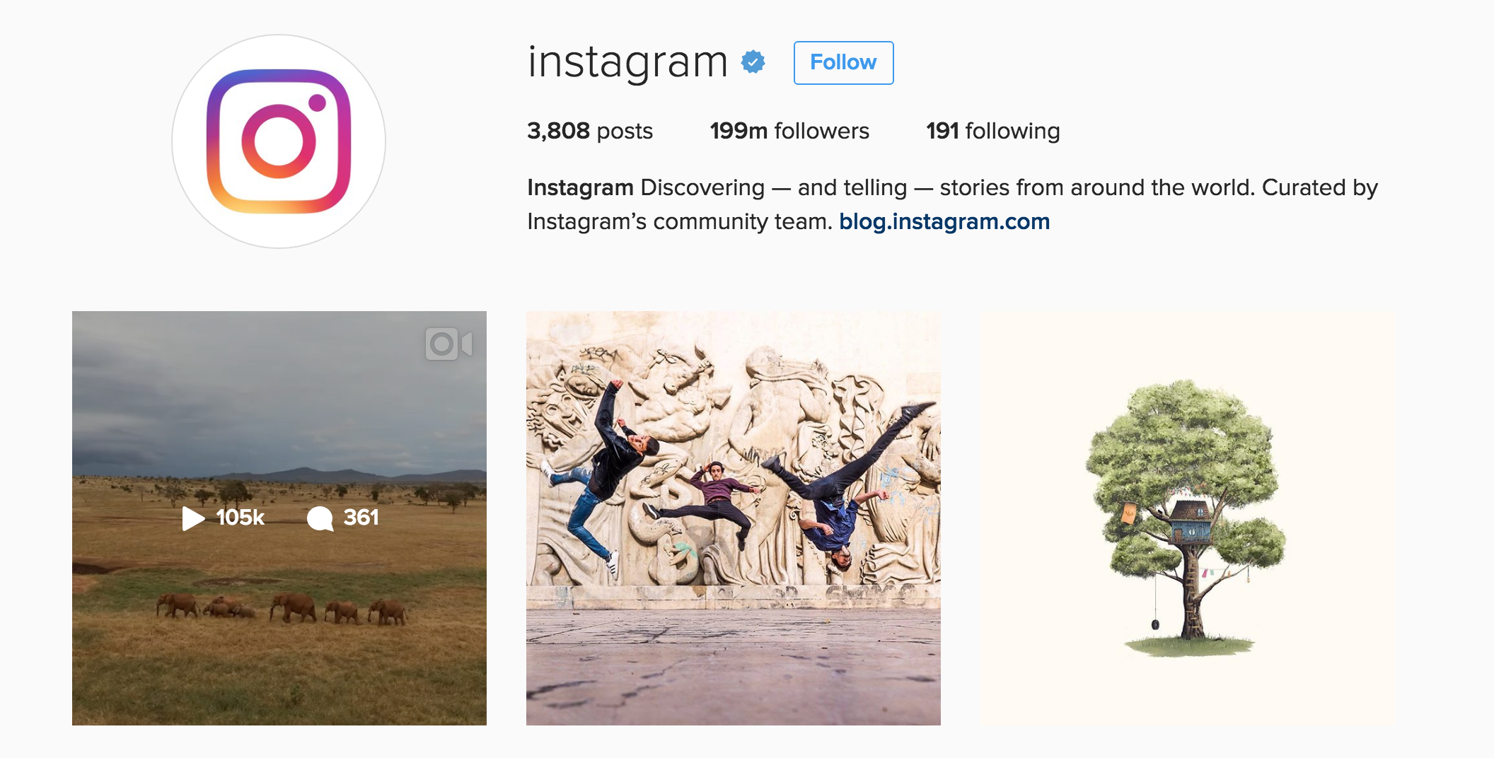
Instagram

Slide 6
Web Scraping
Instagram API: complex and restricted to brands, advertisers, etc.
Instagram official site is dynamically loaded, so instead scraped proxy site: imgrum.net
Imgrum loads instagram files from API and displays them in simple web format
Used Scrapy to scrape @Instagram for all image urls, number of likes, and number of comments
Downloaded images using python library urllib

Slide 7

Imgrum

Slide 8
Prebuilt Image Classifiers
Google’s Inception v3
Image classifier from ImageNet competition released in 2015
Uses deep Convolutional Neural Networks (CNN)
Classifies images into 1000 categories trained on over 1 million images
Clarifai’s object/region classification
Uses Regions with Convolutional neural networks (R-CNN)
Separates image to regions/objects and classifies each individually with CNN

Slide 9
Google’s Inception Image Classifier
Lion, king of beats, panthera leo (score = 0.93634)
Tiger, Panthera tigris (score = 0.00074)
Sundial (score = 0.00070)
Hartebeest (score = 0.00056)
Impala, Aepyceros melampus (score = 0.00049)

Slide 10

Google’s Inception Image Classifier
Crane (score = 0.11851)
Solar dish, solar collector, solar, furnace (score = 0.07567)
Parachute, chute (score = 0.06488)
Steel arch bridge (score = 0.02698)
container ship, containership, container vessel (score = 0.01682)

Slide 11
Clarifai’s Region Classifier
Air (score = 0.99684)
Balloon (score = 0.99685)
Sky (score = 0.99579)
Flying (score = 0.99501)
Freedom (score = 0.99281)

Slide 12
Clarifai’s Region Classifier
Gun (score = 0.99165)
Lid (score = 0.98930)
People (score = 0.98835)
Man (score = 0.984703)
Weapon (score = 0.98191)

Slide 13
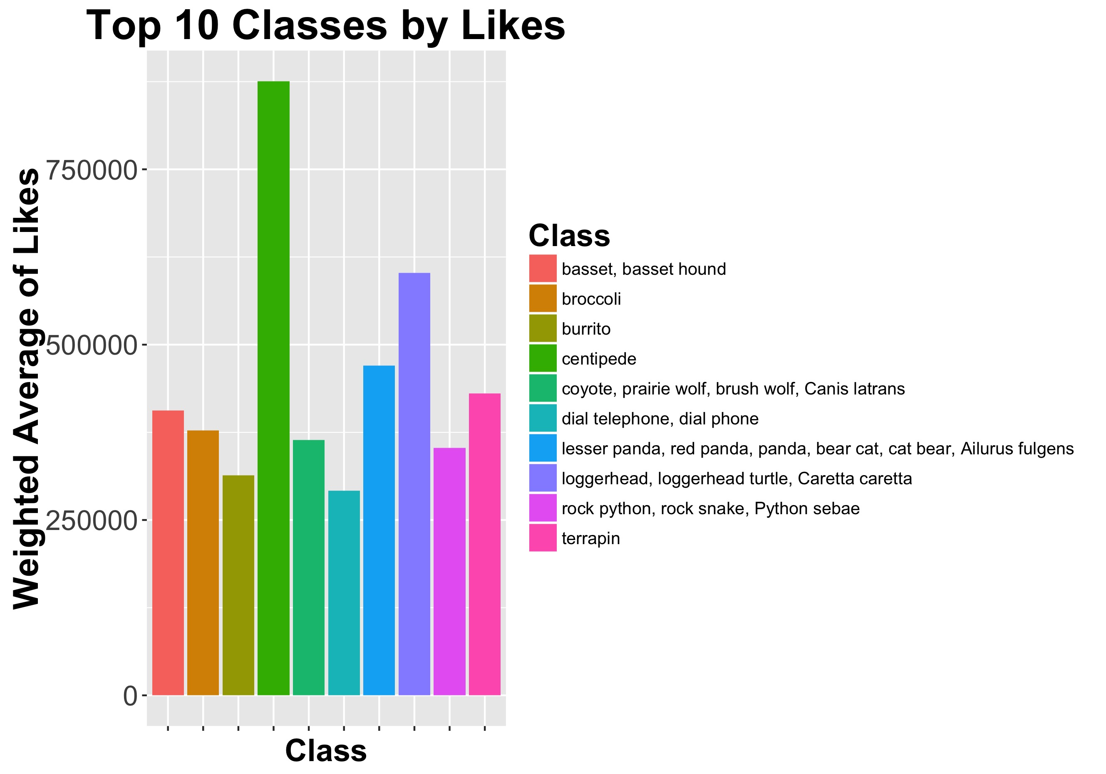
Image Likes by Google Classifier

Slide 14
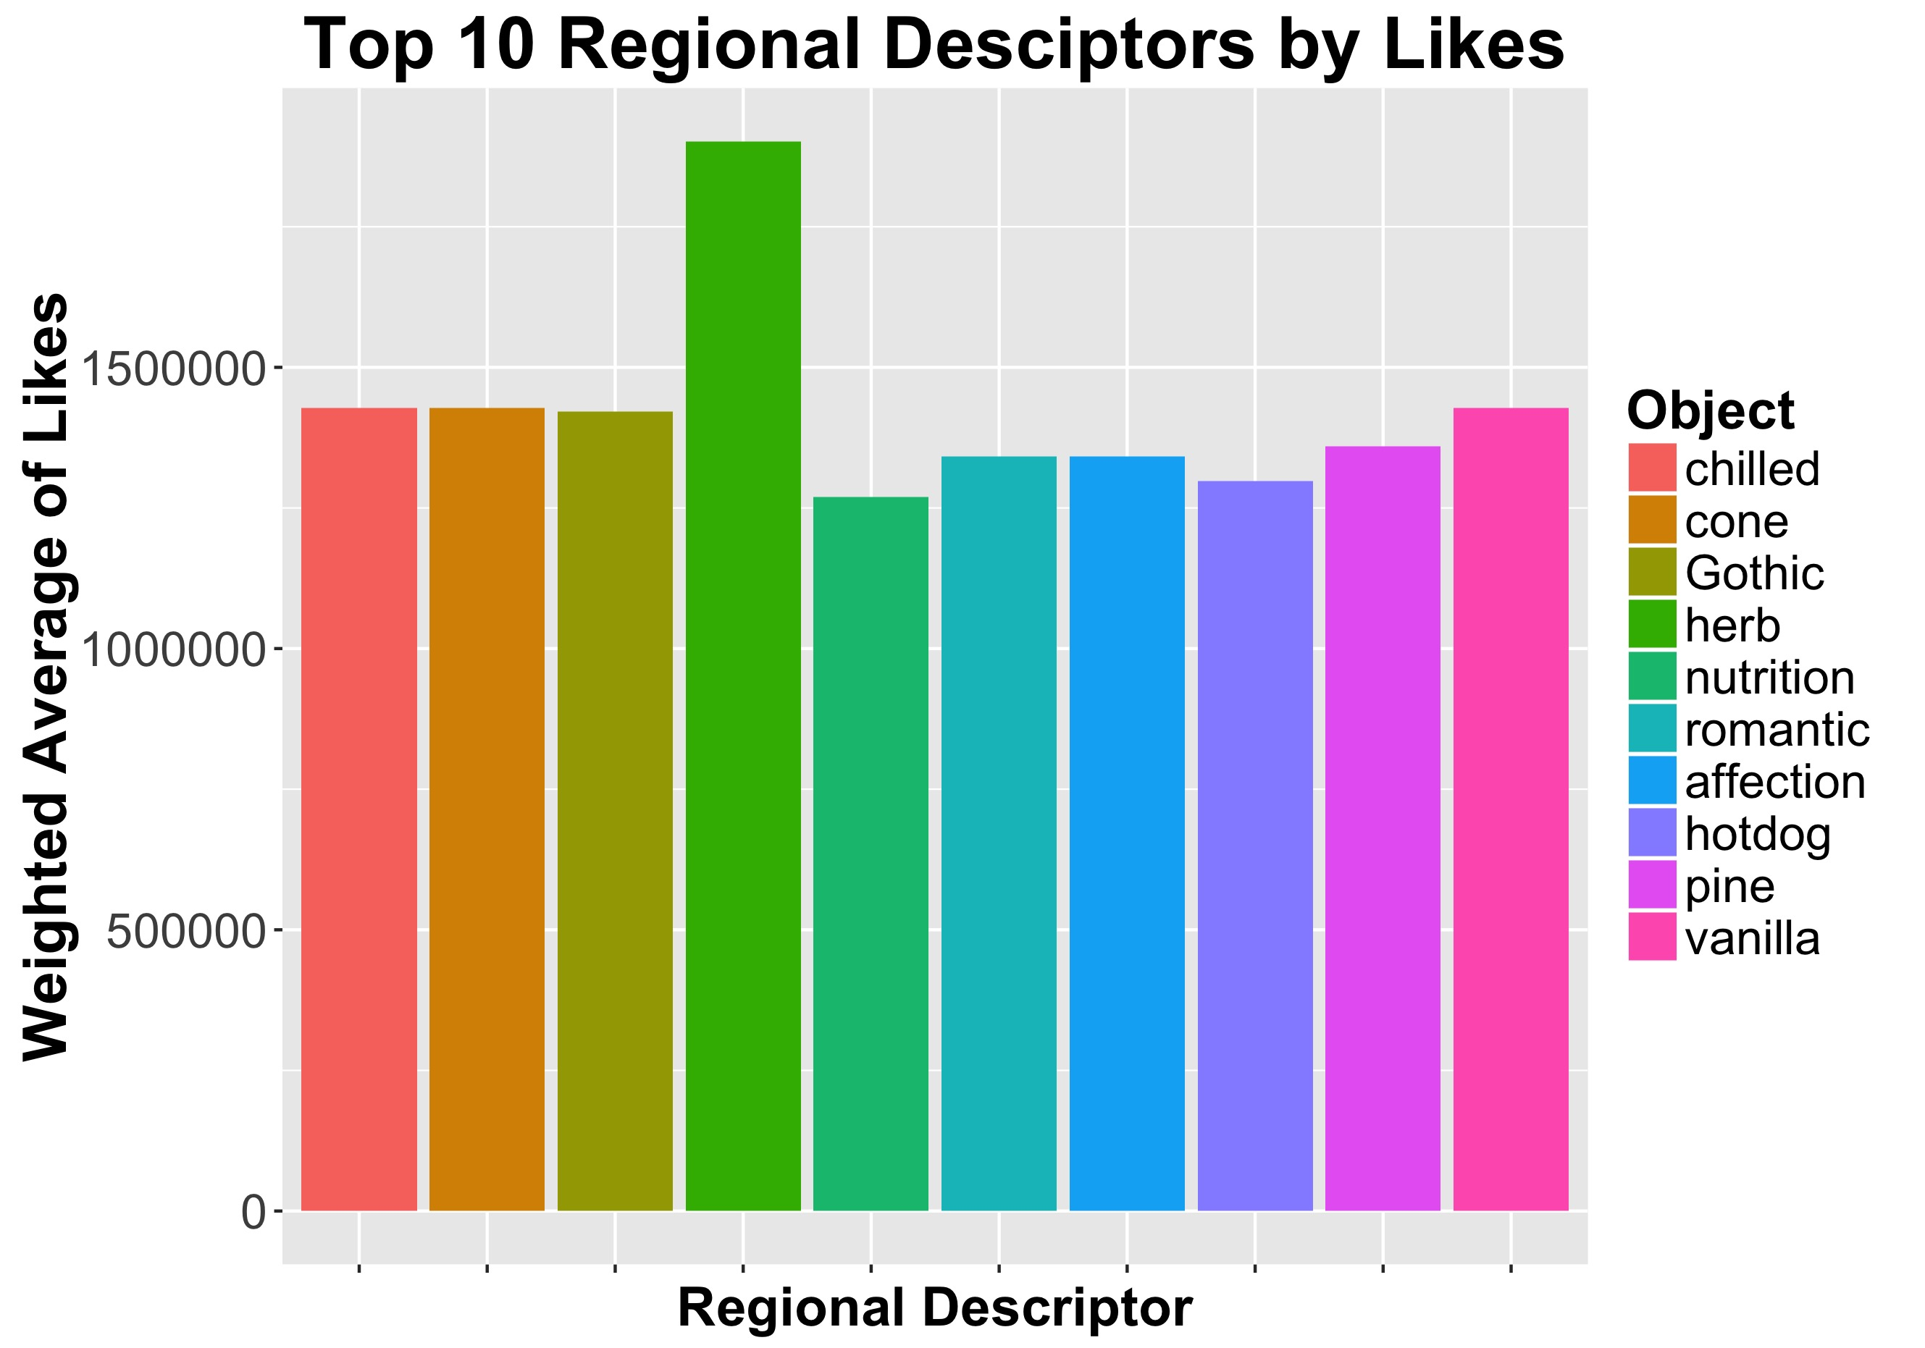
Image Likes by Clarifai Classifier

Slide 15
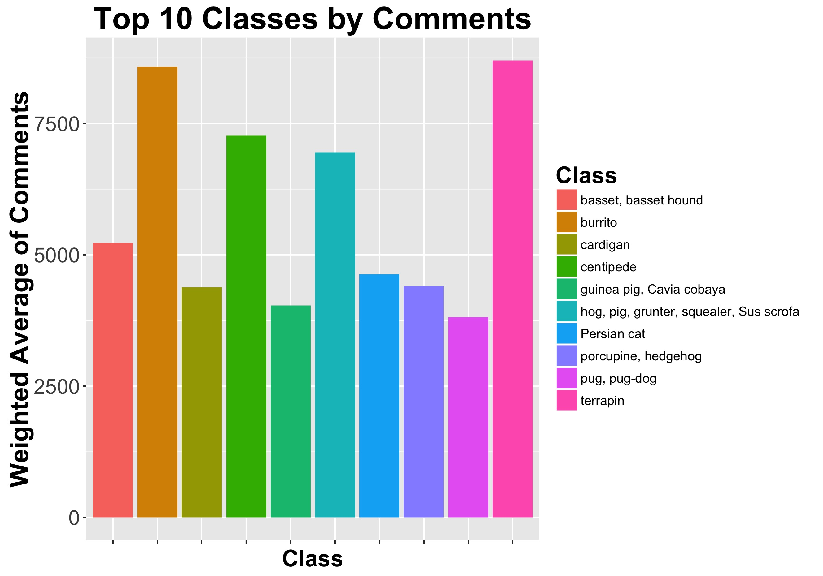
Image Comments by Google Classifier

Slide 16
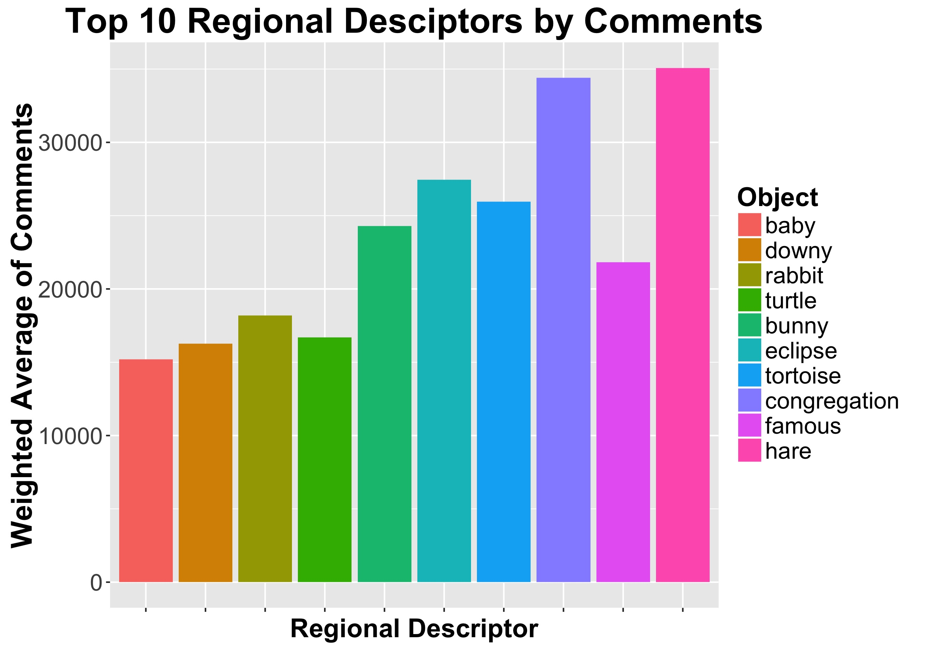
Image Comments by Clarifai Classifier

Slide 17
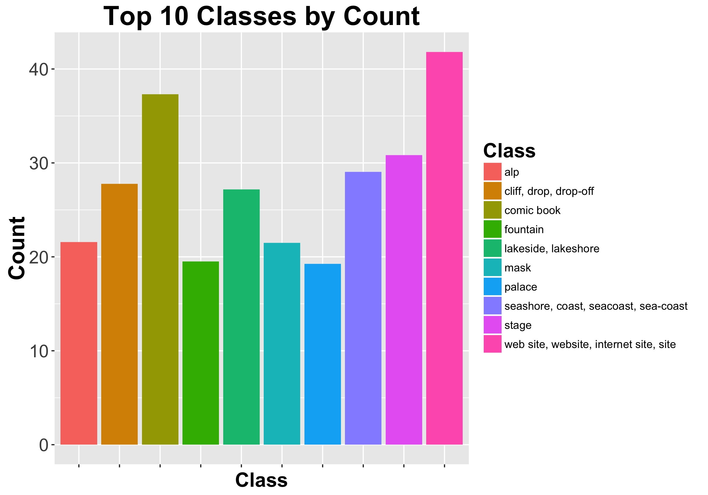
Image Counts by Google Classifier

Slide 18
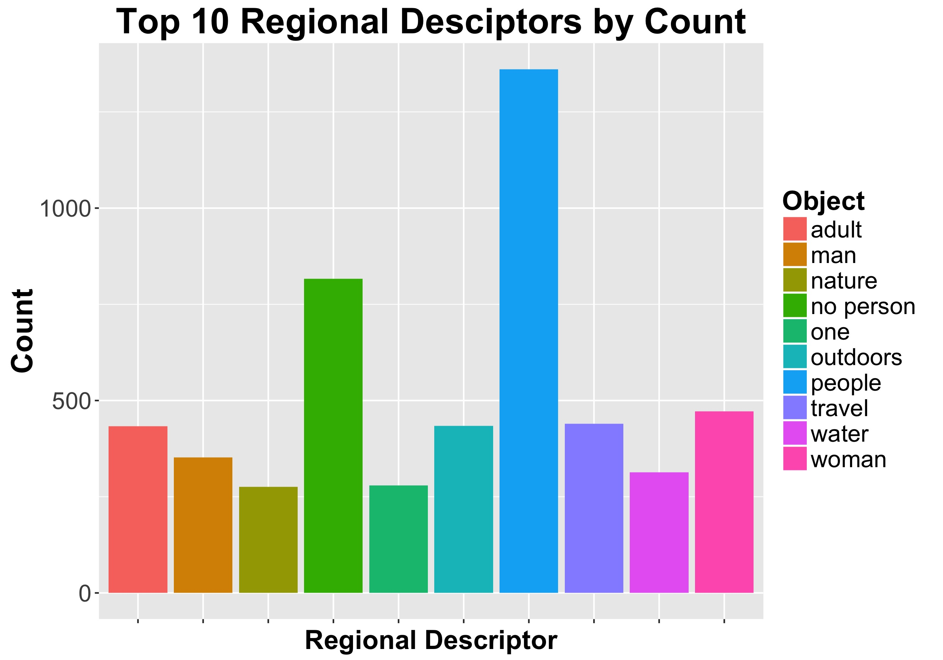
Image Counts by Clarifai Classifier

Slide 19
Conclusion
Web scraping is messy and sometimes out your control (server problems)
Computer vision is pretty awesome (but needs work)
Not all data will be nicely distributed
Clarifai’s system seem to be better than the google classifier, but would cost money

Slide 20
Future Steps
Scrape comments and do Natural Language Processing to gain more insight
Use other computer vision models, i.e google’s show and tell or caffe model zoo
Train new model for specific category (i.e food) and perform similar analysis but on [food] instagram
Fit machine learning model to predict likes/comments

Slide 21
Thank you! Questions?

